Slide 1
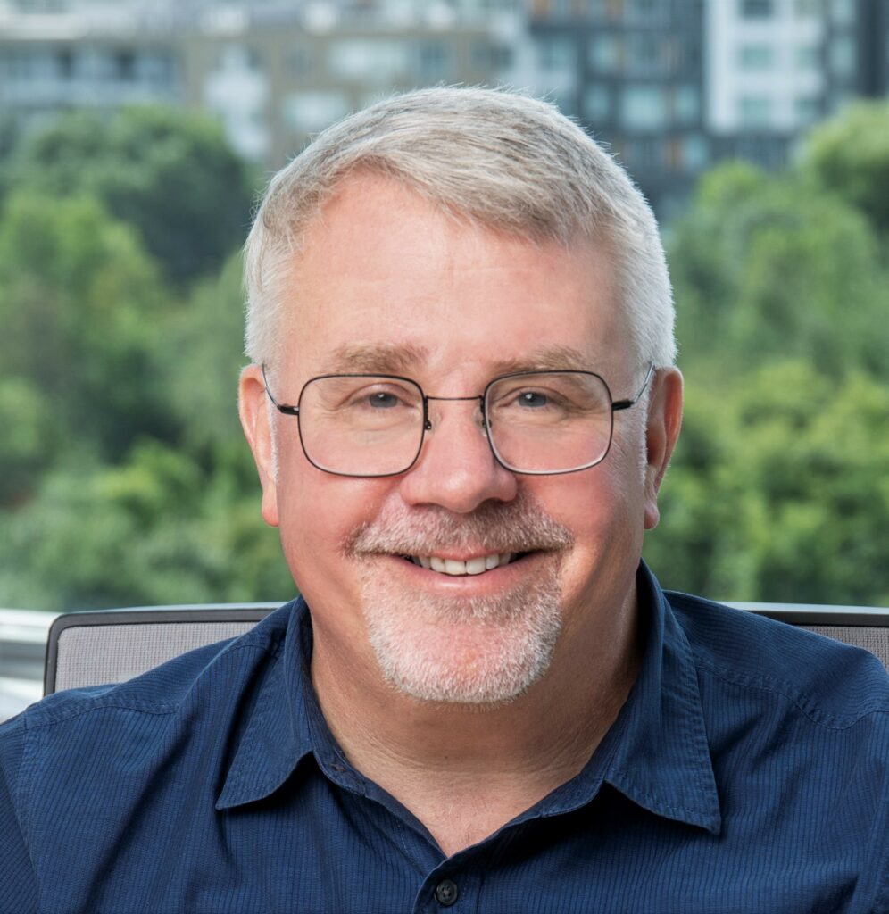
Chimie Verte Academy & Division Chimie Durable (SCF)
Exclusive Joint Webinar
Professor Dr. John C. WARNER
What is Green Chemistry? A journey through its meaning, impact and future
October 9th, 2025

